Slide 1
BERT: The milestones of NLP
& Some applications in Summarization
Yufeng Lv

Slide 2
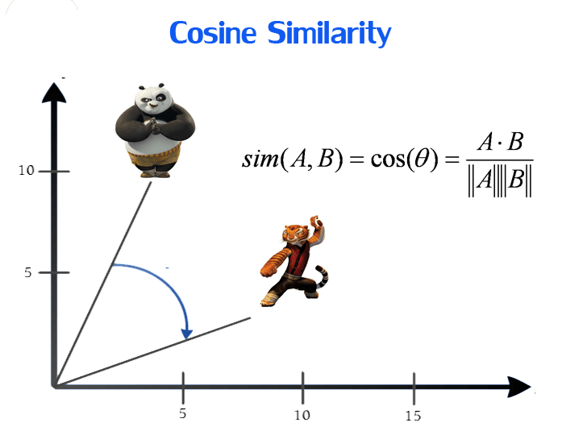
Word Embedding
Map the word into “semantic” space as a point

Slide 3
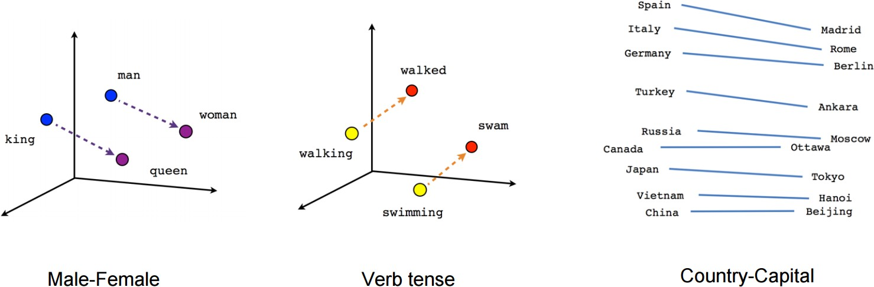
Word Embedding

Slide 4

LSTM
Semantics are context sensitive
Avoids gradient disappearance through gate

Slide 5
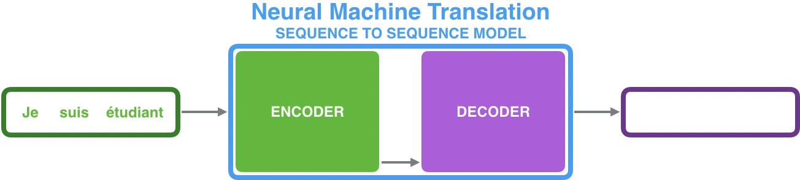

Seq2Seq
Composed of two RNNs
Can be used in Machine translation, summarization, Q&A and dialogue systems

Slide 6
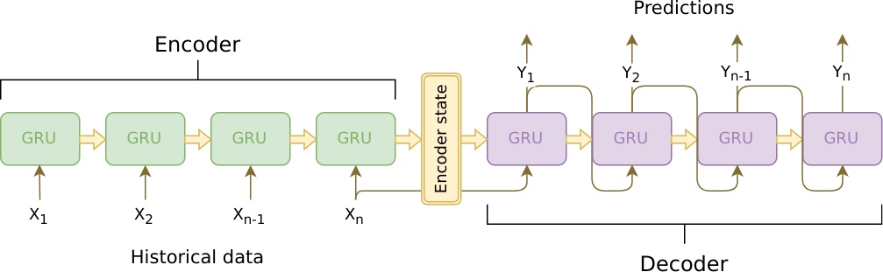
Seq2Seq
Fixed length context vector

Slide 7
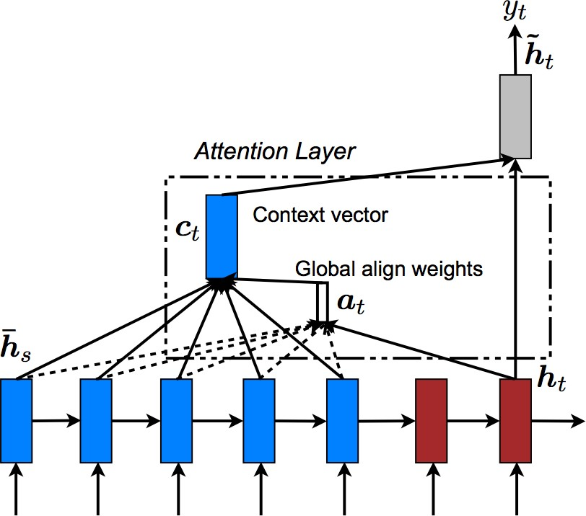
Attention
Pay attention to related word

Slide 8
Problem
The animal didn’t cross the street because it was too tired.
The animal didn’t cross the street because it was too narrow.
The animal didn’t cross the street because it?
it? was too tired.

Slide 9
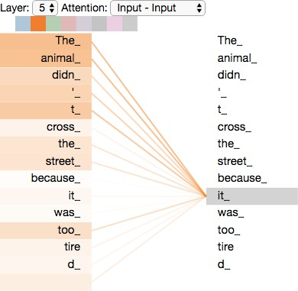
Self-Attention

Slide 10
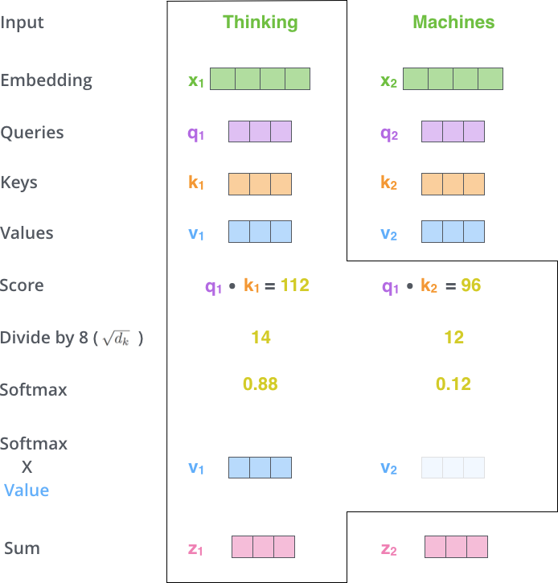
Self-Attention Calculate

Slide 11
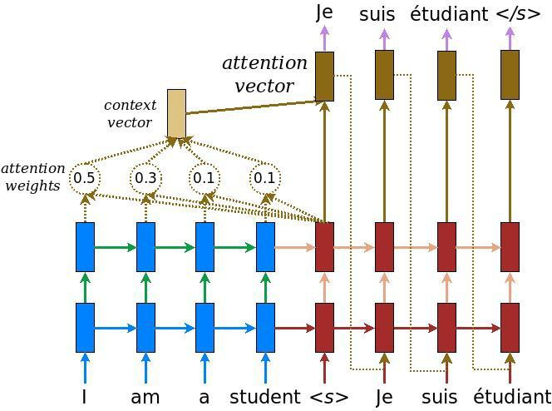
Compare with Normal Attention
Q is decoder’s hidden state
K is encoder’s output
V is encoder’s output

Slide 12
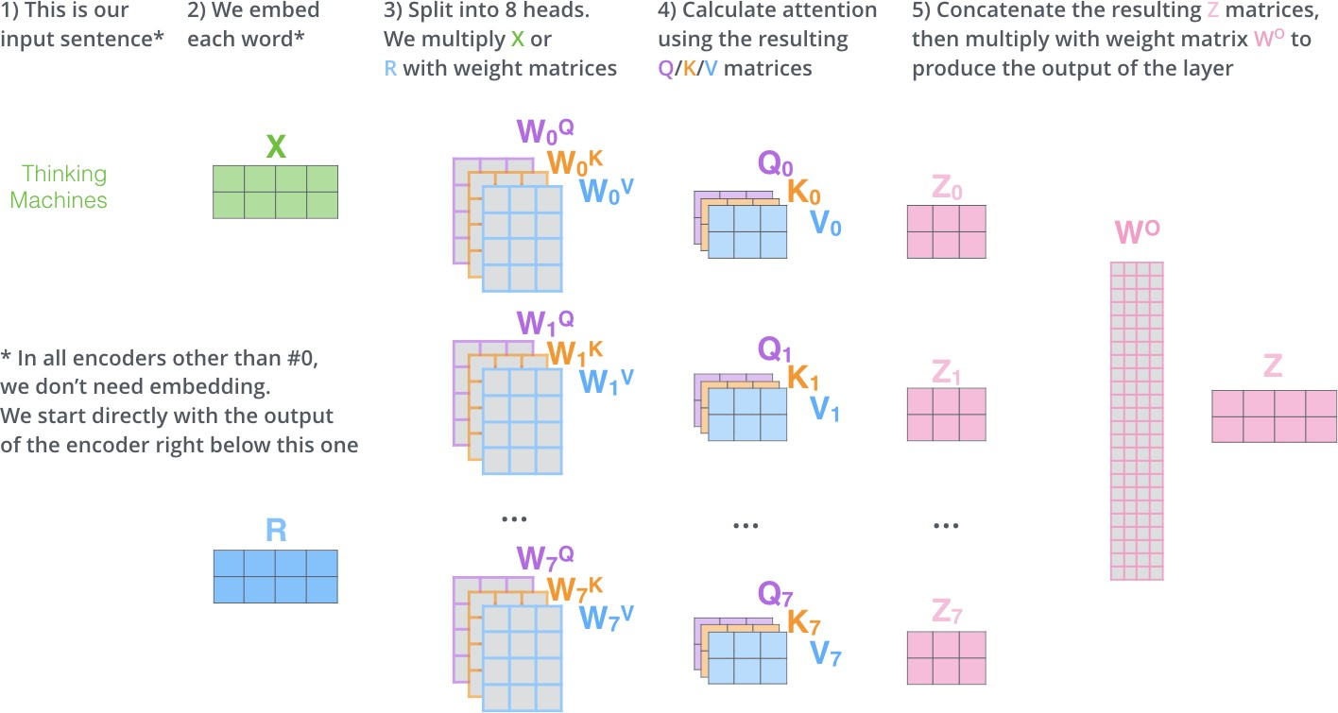
Multi-Heads

Slide 13
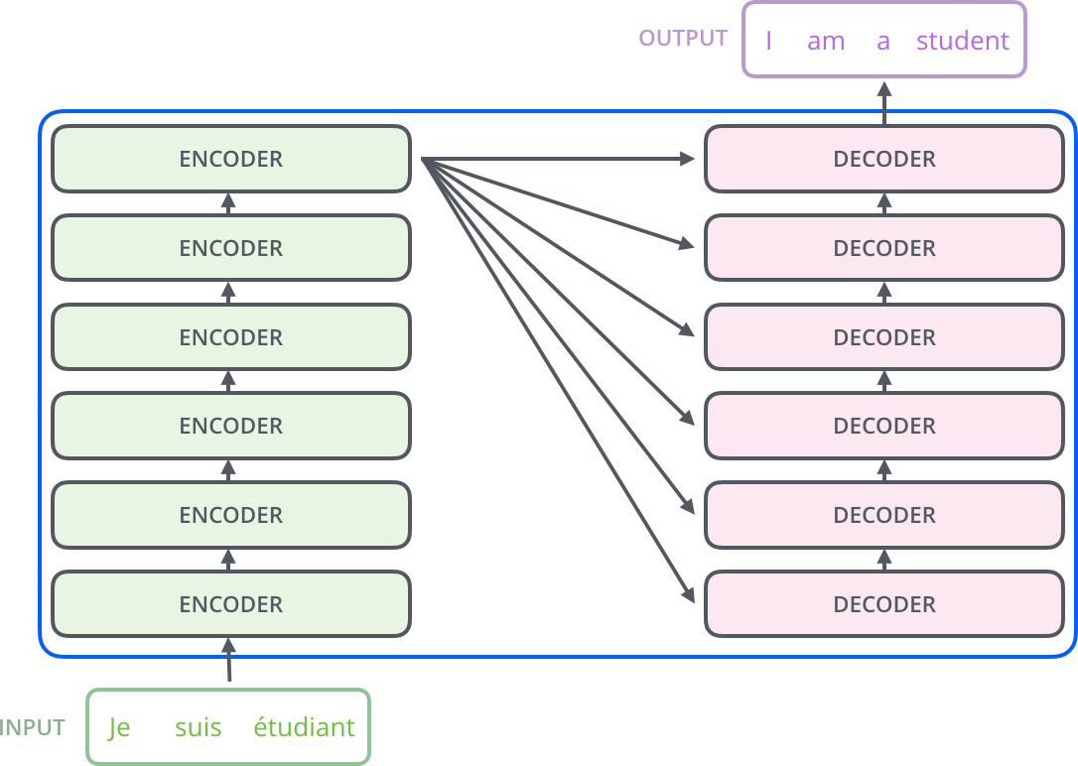
Transformer

Slide 14
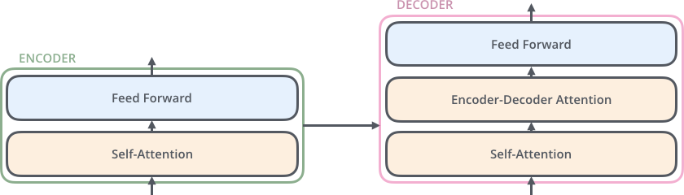
Transformer
One layer Encoder and Decoder

Slide 15
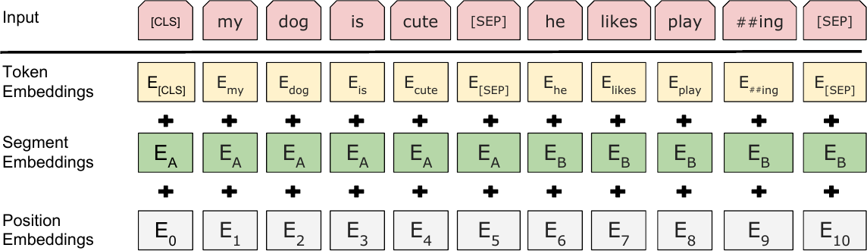
Position Embedding

Slide 16
Contextual Word Embedding
Problems
Word Embedding without context information
Lack of supervised data
Solutions
Unsupervised learning
Contextual Word Embedding

Slide 17
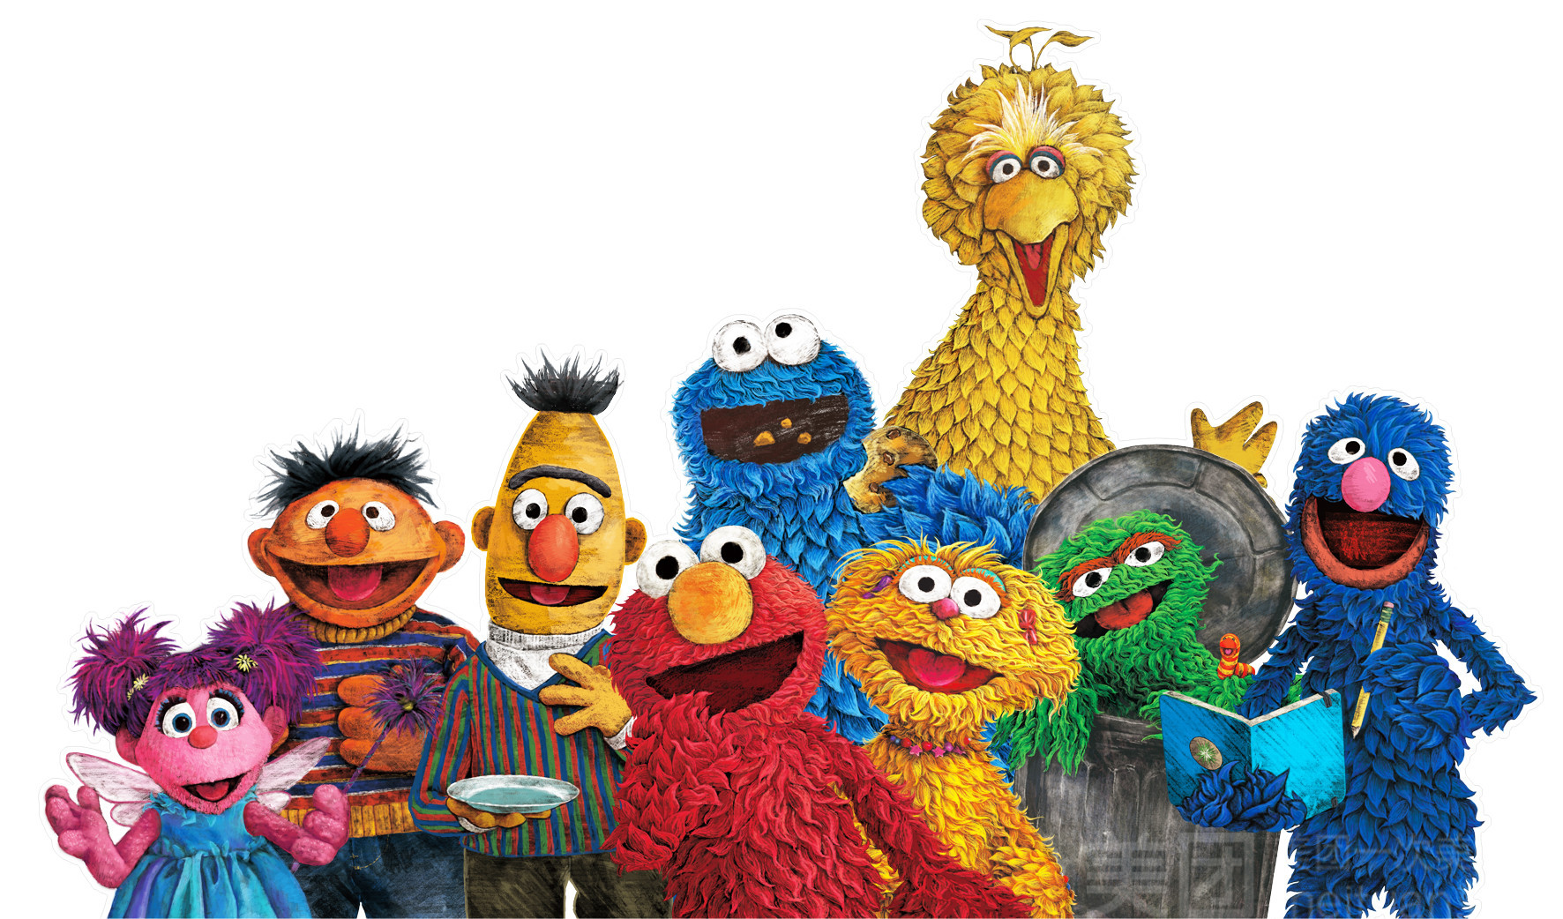

Slide 18
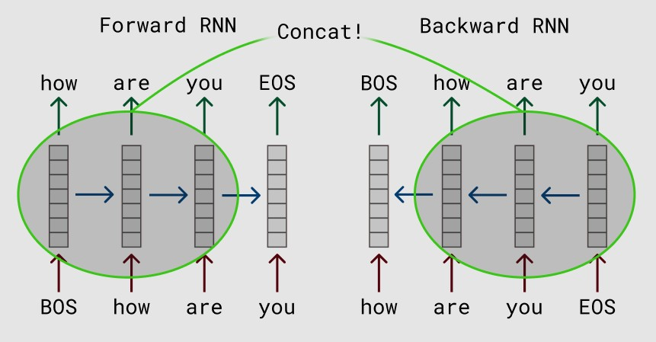
ELMo

Slide 19
ELMo’s Problem
Problems
Not suitable for a specific task
Solutions
Fine-tuning depends on the task
Use Transformer replace RNN/LSTM

Slide 20
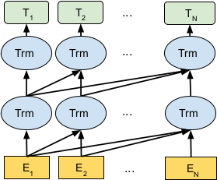
OpenAI GPT

Slide 21
GPT’s Problem
Problems
Unidirectional
Pre-training and Fine-tuning not matched
Solutions
Masked LM
NSP Multi-task Learning

Slide 22
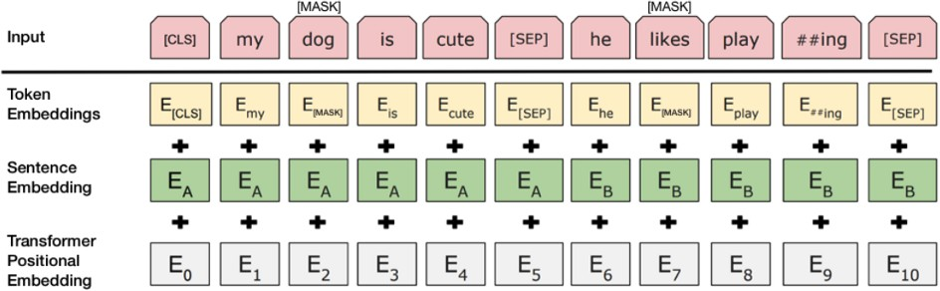
Masked LM
Random mask 15% words, and use BERT to predict

Slide 23
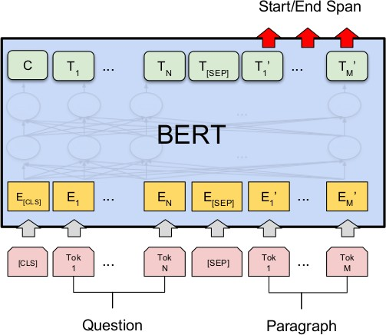
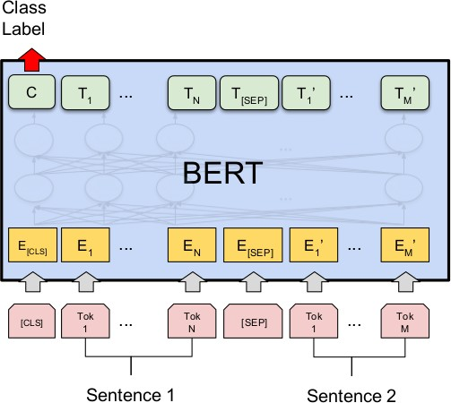
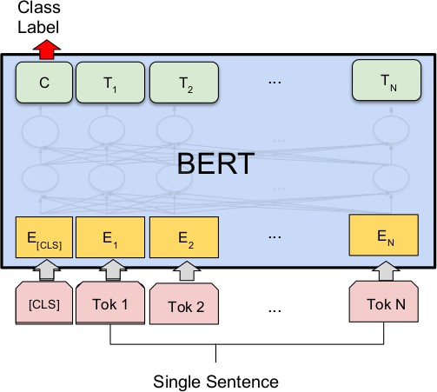
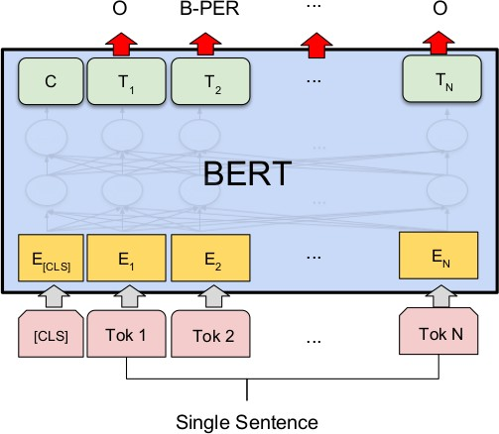
Fine-Tuning

Slide 24
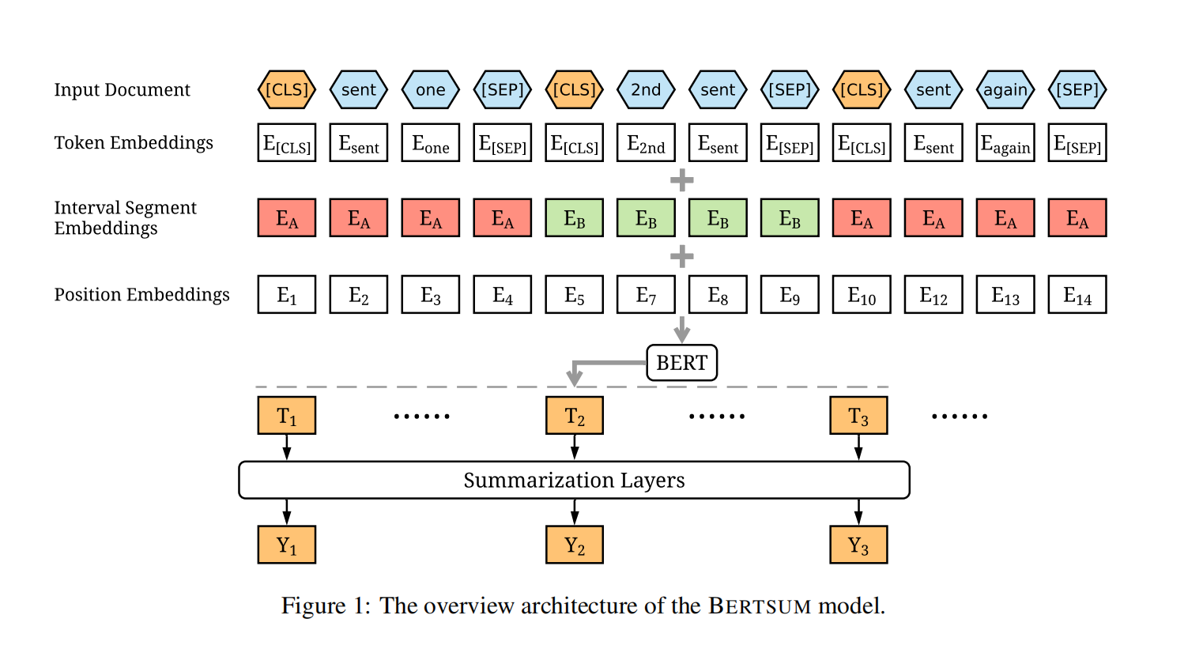
Simple Fine-Tuning for Summarization

Slide 25
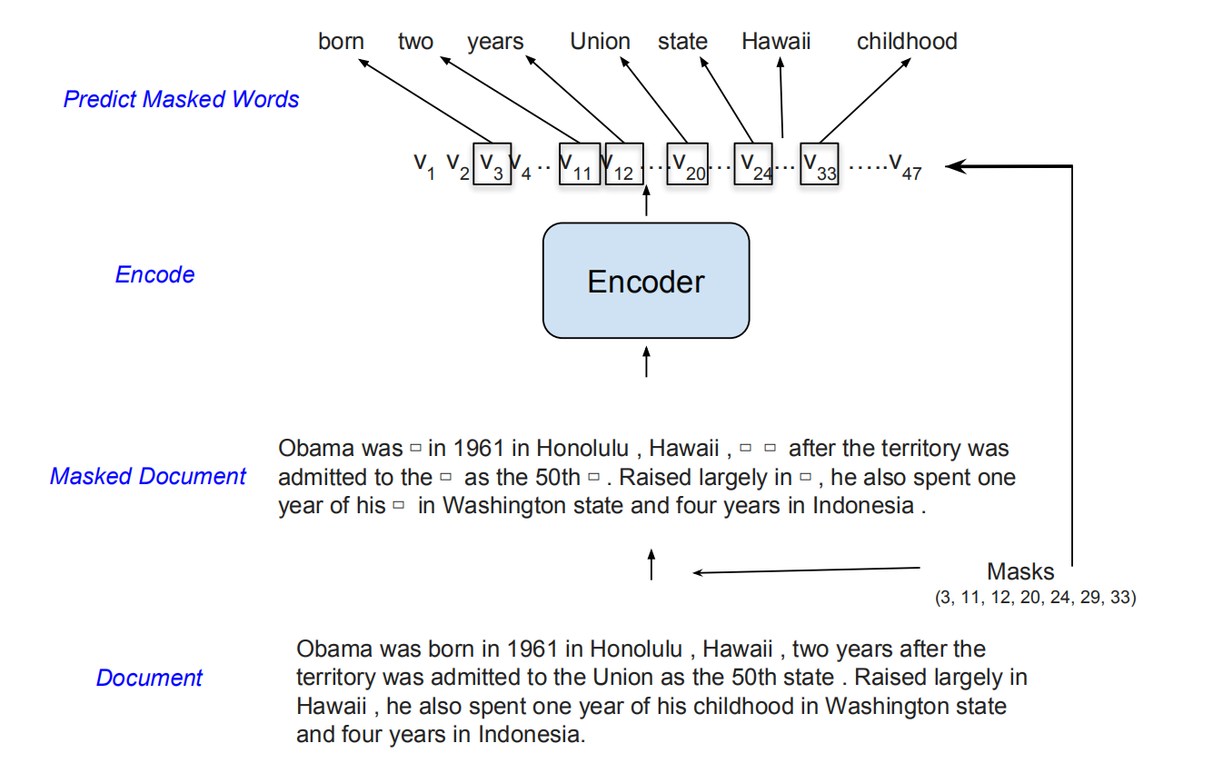
Hierarchical Document Representations

Slide 26
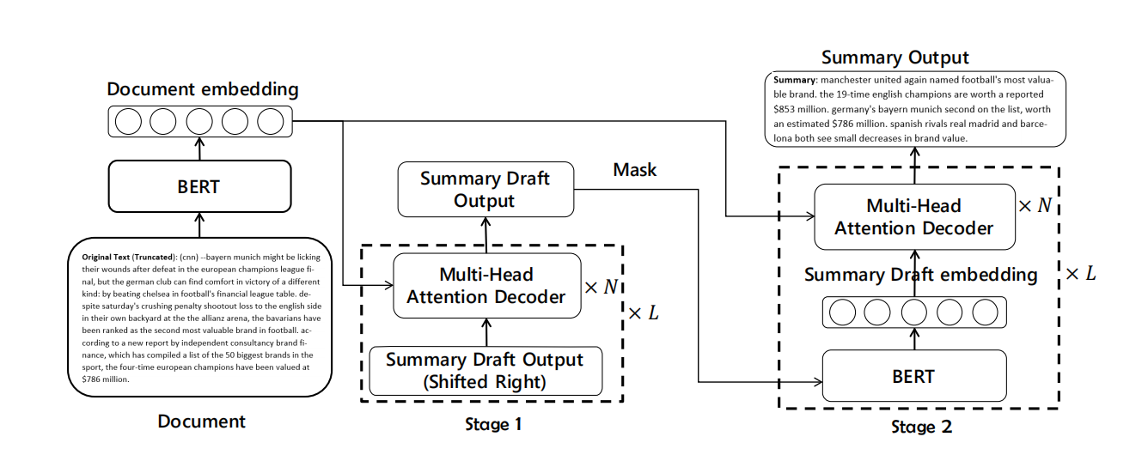
Two-stage refined method

Slide 27
References
1. Vaswani A, Shazeer N, Parmar N, et al. Attention Is All You Need. arXiv:170603762 [cs]. June 2017. http://arxiv.org/abs/1706.03762. Accessed April 23, 2019.
2. Devlin J, Chang M-W, Lee K, Toutanova K. BERT: Pre-training of Deep Bidirectional Transformers for Language Understanding. arXiv:181004805 [cs]. October 2018. http://arxiv.org/abs/1810.04805. Accessed April 23, 2019.
3. Peters ME, Neumann M, Iyyer M, et al. Deep contextualized word representations. arXiv:180205365 [cs]. February 2018. http://arxiv.org/abs/1802.05365. Accessed April 23, 2019.
4. Liu Y. Fine-tune BERT for Extractive Summarization. arXiv:190310318 [cs]. March 2019. http://arxiv.org/abs/1903.10318. Accessed April 8, 2019.
5. Chang M-W, Toutanova K, Lee K, Devlin J. Language Model Pre-training for Hierarchical Document Representations. arXiv:190109128 [cs]. January 2019. http://arxiv.org/abs/1901.09128. Accessed April 8, 2019.
6. Radford A, Wu J, Child R, Luan D, Amodei D, Sutskever I. Language Models are Unsupervised Multitask Learners. :24.
8. Zhang H, Gong Y, Yan Y, et al. Pretraining-Based Natural Language Generation for Text Summarization. arXiv:190209243 [cs]. February 2019. http://arxiv.org/abs/1902.09243. Accessed April 8, 2019.

